Slide 1
Types of data

Slide 2
INTERNAL DATA
Most organizations build their first data warehouse efforts on data whose source is existing systems (that is, on data internal to the corporation).
In almost every case, this data can be termed internal, structured data.
The data comes internally from the corporation and has been already shaped into a regularly occurring format.

Slide 3
EXTERNAL DATA
A data that is not to be generated from the corporation’s own systems is called the External Data.
The data warehouse is the ideal place to store external data.
When this type of data enters the corporation in an undisciplined fashion, the identity of the source of the data is lost, and there is no coordination whatsoever in the orderly use of the data.

Slide 4
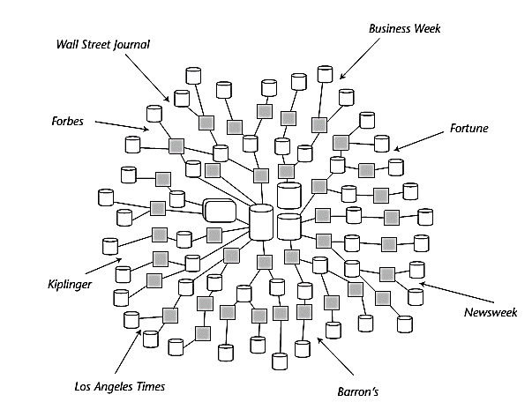

Slide 5
EXTERNAL DATA
There are two basic types of external data:
Records of external data collected by some source (such as a drug store, a supermarket, and so forth).
External data from random reports, articles, and other sources.
Some typical sources of interesting and useful external data include the following: Marketing comparison and analysis reports, Sales analysis and comparison reports etc.

Slide 6
EXTERNAL DATA
Several issues relate to the use and storage of external data in the data warehouse:
Unlike internally appearing data, there is no real fixed pattern of appearance for external data and constant monitoring must be set up to ensure that the right external data is captured.
The second problem with external data is that it is Totally Undisciplined. To be useful, and for placement in the warehouse, a certain amount of reformatting and structuring of external data is needed to transform it into an internally acceptable and usable form in the data warehouse.

Slide 7
EXTERNAL DATA
In some cases, the level of granularity of the external data will not match that of the internal systems of the corporation.
The next factor that makes external data hard to capture and use is its unpredictability. External data may come from practically any source at almost any time.

Slide 8
Storing EXTERNAL DATA
External data can actually be stored in the data warehouse if it is convenient and cost-effective to do so.
But in many cases, it will not be possible or economical to store all external data in the data warehouse. Instead, an entry is made in the metadata of the warehouse describing where the actual body of external data can be found.
The external data is then stored elsewhere, where it is convenient.

Slide 9
reference DATA
The another type of data belongs in the data warehouse is reference data.
The reference data tables, stored in addition to basic data in data mart/ data warehouse help and enable the end users of the data mart/ data warehouse to relate the data to its expanded version.
Reference data is particularly applicable to the data warehouse environment because it helps reduce the volume of data significantly.

Slide 10
reference DATA
There are many design techniques for the management of reference data.
The first design option, where a snapshot of an entire reference table is taken in every six months. This approach is quite simple and at first glance appears to make sense. But the approach is logically incomplete.
For example, suppose some activity had occurred to the reference table on March 15. Say a new entry, ddw, was added, and then on May 10 the entry for ddw was deleted. Taking a snapshot every six months would not capture the activity that transpired from March 15 to May 10.

Slide 11
reference DATA
A second approach, at some starting point, a snapshot is made of a reference table. Throughout the year, all the activities against the reference table are collected. To determine the status of a given entry to the reference table at a moment in time, the activity is reconstituted against the reference table. In such a manner, logical completeness of the table can be reconstructed for any moment in time.

